Slide 1
Networked Environment for Music Analysis (NEMA)
Andrew Shirk, IMIRSEL, GSLIS, UIUC

Slide 2
Credits and Acknowledgements
Funding Provided By
Andrew W. Mellon foundation
Co-authors
Kris West, Amit Kumar, Guojun Zhu, J. Stephen Downie, Andreas Ehmann, Mert Bay
IMIRSEL
International Music Information Retrieval Systems Evaluation Laboratory
The goal of the IMIRSEL is to advance the state-of-the-art in Music Information Retrieval research

Slide 3
Agenda
Definitions
Background
Project Goals
Implementation
MIR Tasks as Workflows
User Interface
Workflow Processing
Remote Executors
Job Results
Future Directions

Slide 4
Agenda
Definitions
Background
Project Goals
Implementation
MIR Tasks as Workflows
User Interface
Workflow Processing
Remote Executors
Job Results
Future Directions

Slide 5
Definitions
MIR
Music Information Retrieval
MIR Task
A specific, well-defined MIR problem, for example:
Artist Identification
Mood Classification
Music Collection
A large body of audio tracks from a common source
Dataset
Datasets aggregate sets of audio tracks, metadata about the tracks, and machine learning parameters needed to execute a particular task.

Slide 6
Definitions
MIR
Music Information Retrieval
MIR Task
A specific, well-defined MIR problem, for example:
Artist Identification
Mood Classification
Music Collection
A large body of audio tracks from a common source
Dataset
Datasets aggregate sets of audio tracks, metadata about the tracks, and machine learning parameters needed to execute a particular task.

Slide 7
Agenda
Definitions
Background
Project Goals
Implementation
MIR Tasks as Workflows
User Interface
Workflow Processing
Remote Executors
Job Results
Future Directions

Slide 8
Collection Access Restrictions
Copyright restrictions prohibit sharing of large music collections between researchers
Licenses are prohibitively expensive
Use of creative commons collections is not a good solution
Small scale collections
Widespread use within the MIR community leads to overfitting of models

Slide 9
MIREX
Music collections challenges led to the establishment of MIREX
Music Information Retrieval Evaluation eXchange
An annual competition since 2005
Researchers submit (to IMIRSEL) MIR algorithms to be manually executed against large music collections, and evaluated using standardized measures
MIREX drives MIR research by encouraging the community to define new tasks, algorithms and evaluation procedures
MIREX has required enormous effort by the IMIRSEL team in the execution, debugging, and validation of submitted code

Slide 10
Agenda
Definitions
Background
Project Goals
Implementation
MIR Tasks as Workflows
User Interface
Workflow Processing
Remote Executors
Job Results
Future Directions

Slide 11
Project Goals
Service-oriented infrastructure for the submission and automated execution of MIR compute tasks
Movement and execution of arbitrary, user-submitted code
Support heterogeneous execution environments
Support the use of distributed music collections
Enforce security of music collections
Promote sharing of techniques and algorithms

Slide 12
Agenda
Definitions
Background
Project Goals
Implementation
MIR Tasks as Workflows
User Interface
Workflow Processing
Remote Executors
Job Results
Future Directions

Slide 13
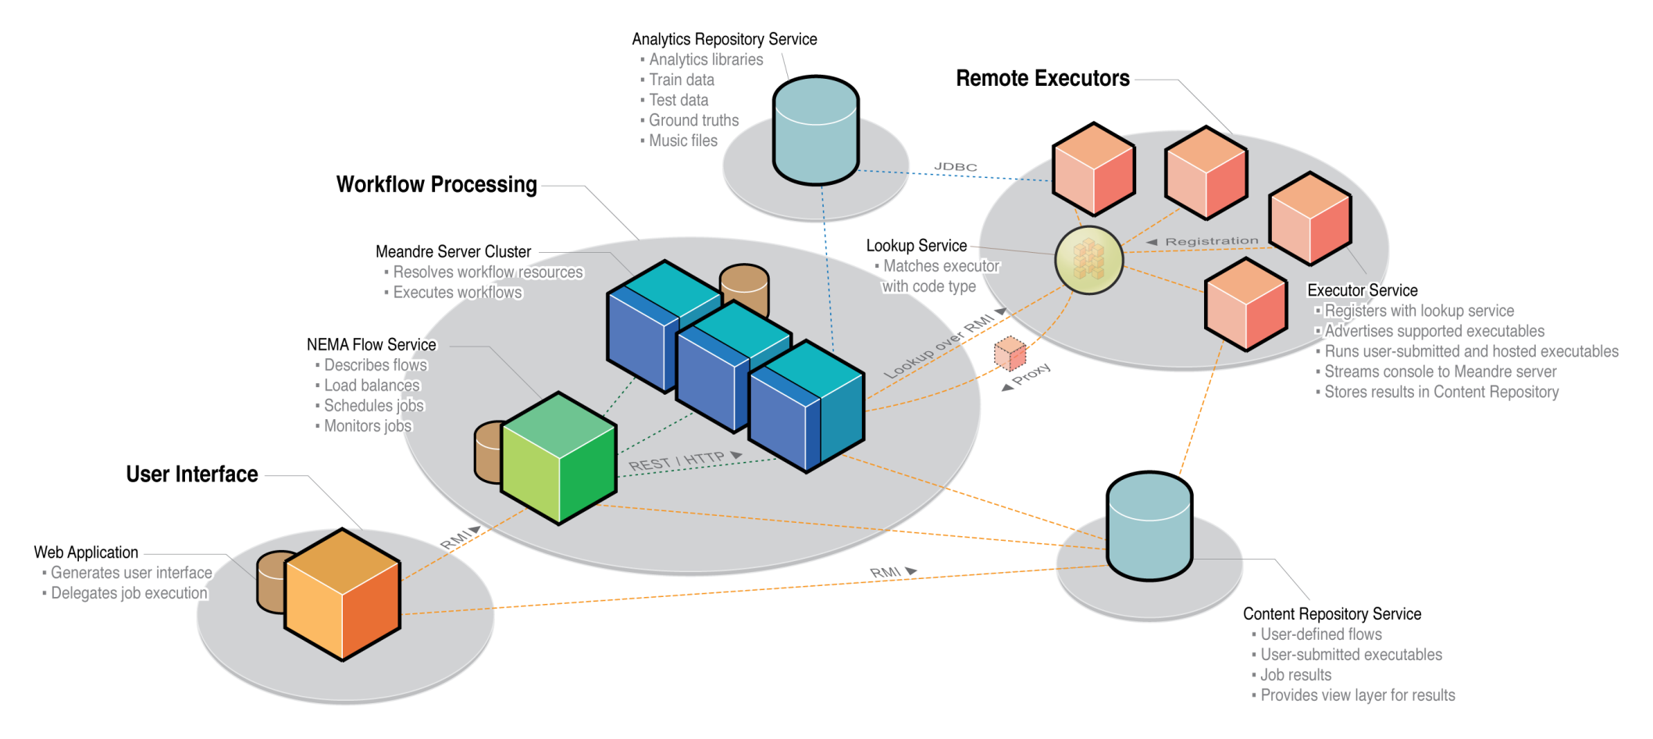
NEMA System Overview (Logical)

Slide 14
Agenda
Definitions
Background
Project Goals
Implementation
MIR Tasks as Workflows
User Interface
Workflow Processing
Remote Executors
Job Results
Future Directions

Slide 15
Tasks as Workflows
MIR tasks can be broken down into discrete units of work
Task “components”
e.g. dataset selection, dataset analysis, result evaluation
Component execution can be delegated to remote executors to satisfy collection access restrictions
Workflow-based computing facilitates repeatable experiments and valid comparisons between runs

Slide 16
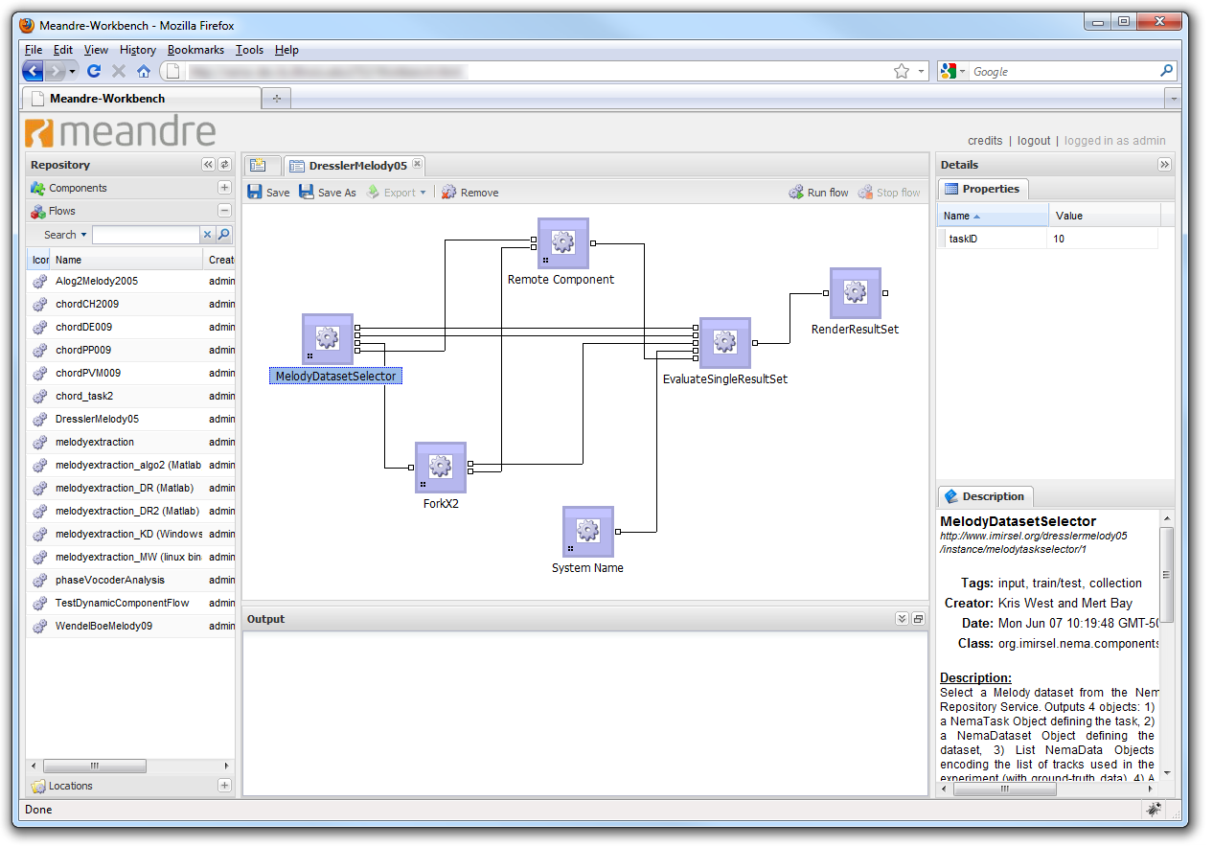
Meandre
NEMA uses Meandre (NCSA) to implement its workflow processes
Meandre provides basic infrastructure for creating and executing flows
RDF-based models for executable components, flows, and repositories
Meandre Workbench for visually wiring together components to create flows
Meandre Server for executing flows

Slide 17
Agenda
Definitions
Background
Project Goals
Implementation
MIR Tasks as Workflows
User Interface
Workflow Processing
Remote Executors
Job Results
Future Directions

Slide 18
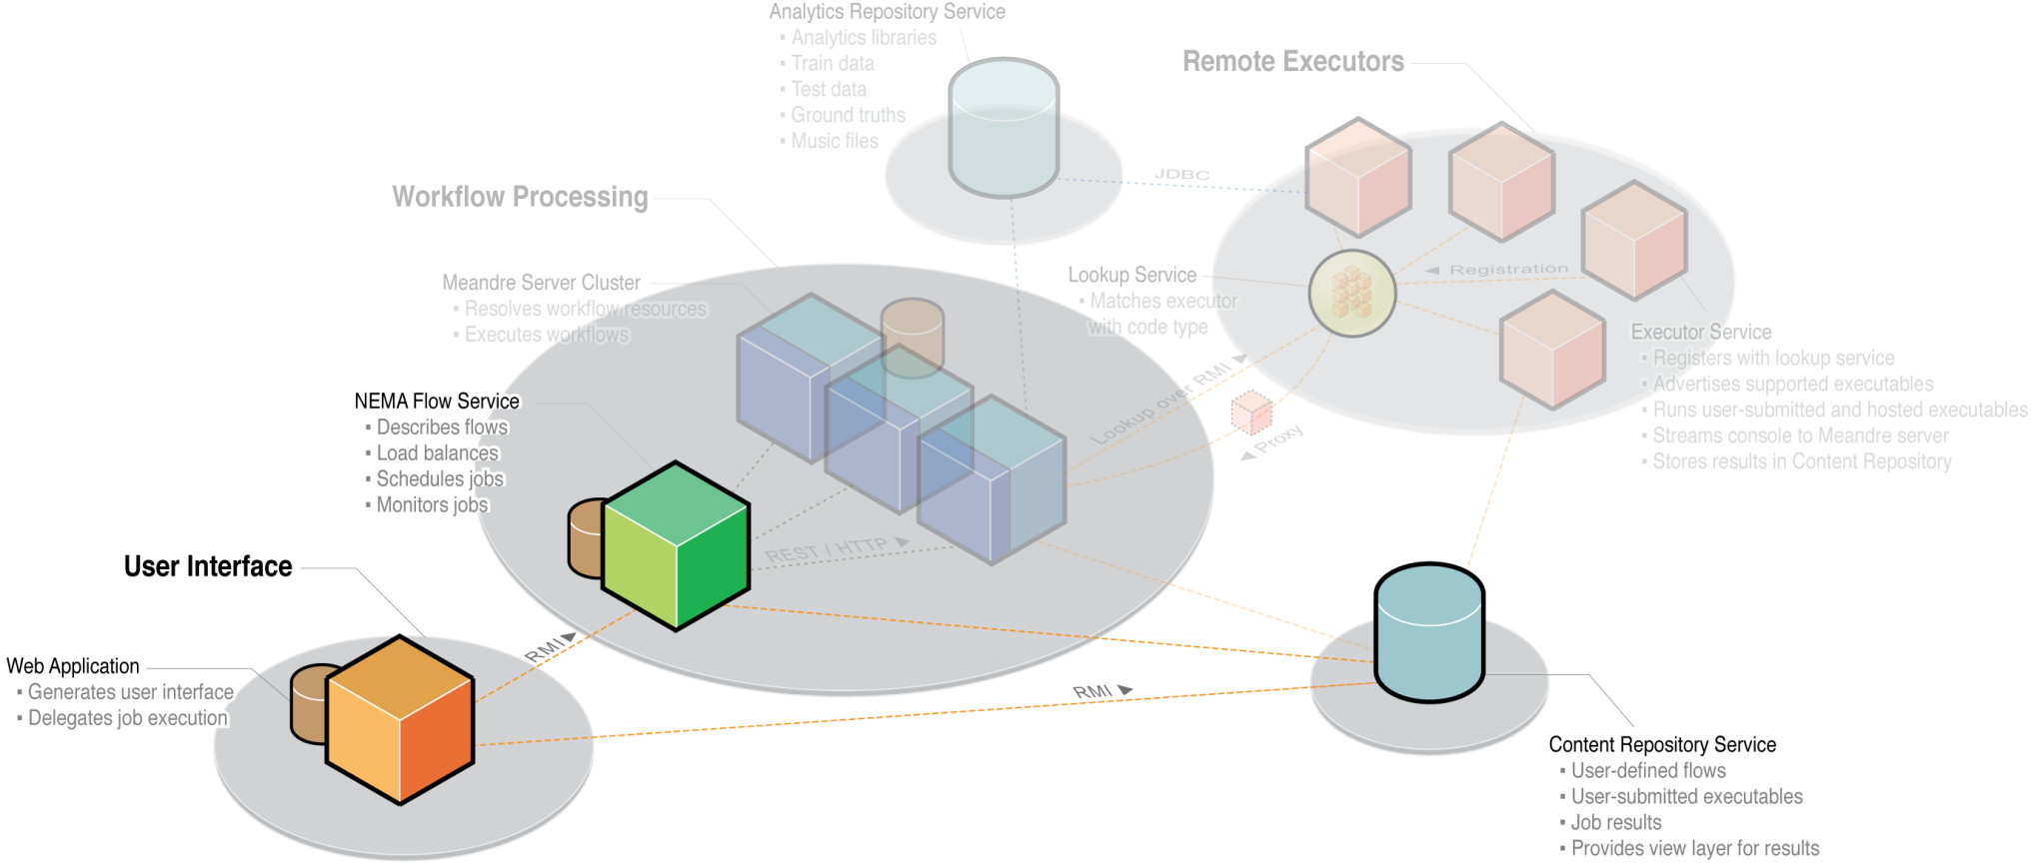
User Interface

Slide 19
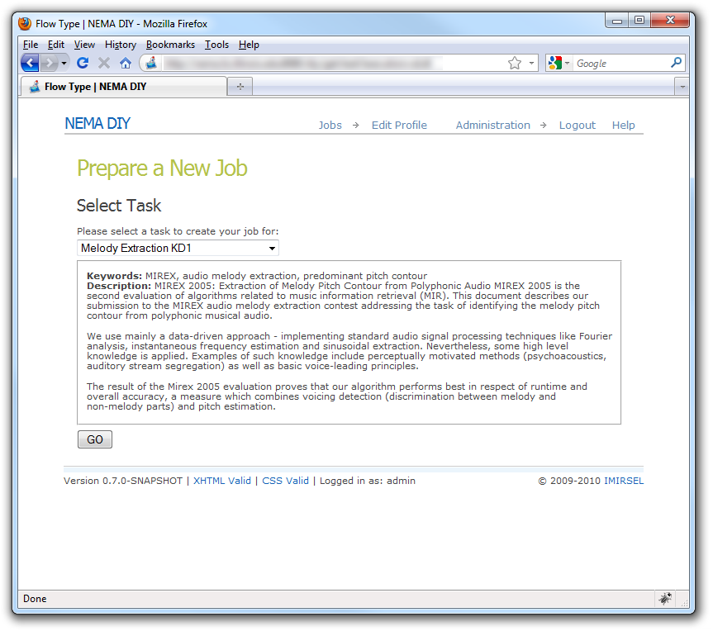
Selecting a Task
Users select from the list of available MIR tasks in order to run a new job
“Task templates”
Each task template corresponds to a flow in our central Meandre repository

Slide 20
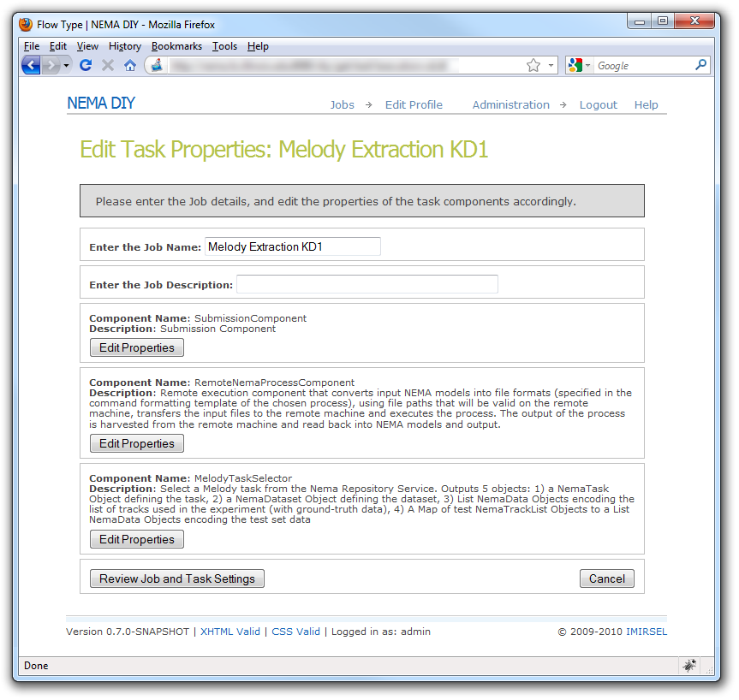

Configuring a Task
NEMA Flow Service is queried for the components that make up the flow
User edits component properties to configure the flow instance

Slide 21
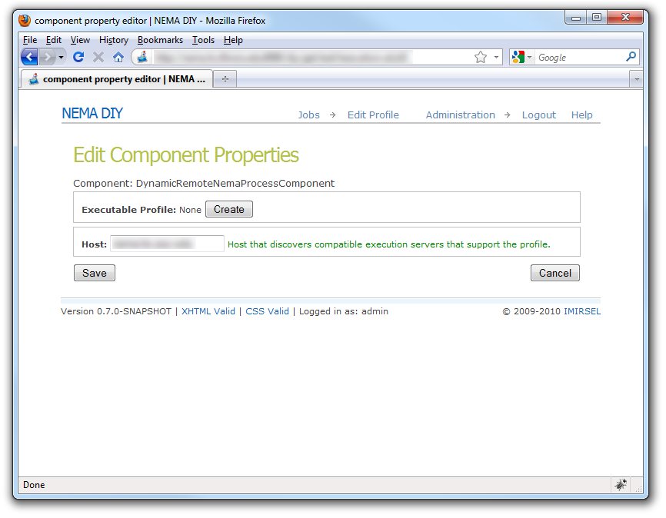
Configuring Remote Components
Shown is a “Dynamic Remote Component”
The “Executable Profile” property fully describes the executable that needs to be run
The “Host” property specifies the address of the remote executor lookup service

Slide 22
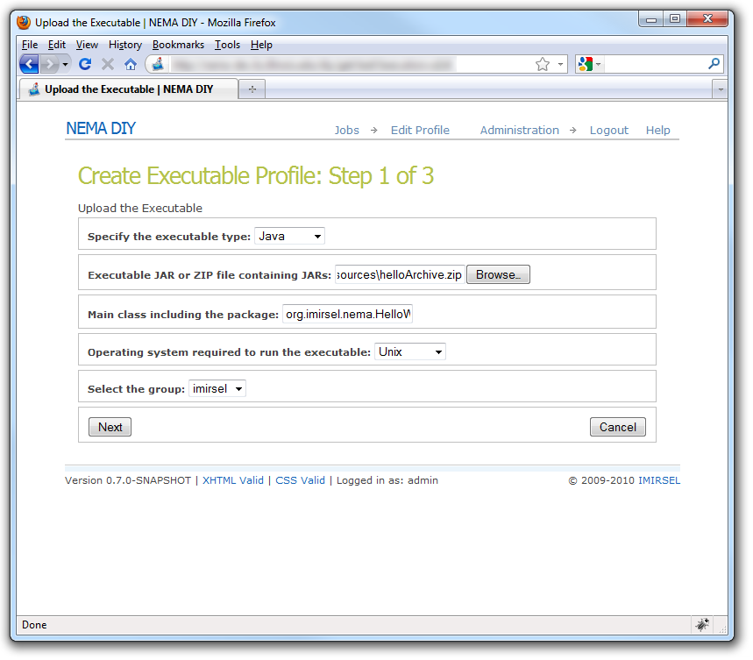
Configuring Remote Components
User-submitted executables can be coded in Java, MATLAB, Binary (C, C++, etc.), Perl, Python, Wine, Shell or Ruby
User uploads an archive containing the executable entry point, supporting libraries and resources

Slide 23
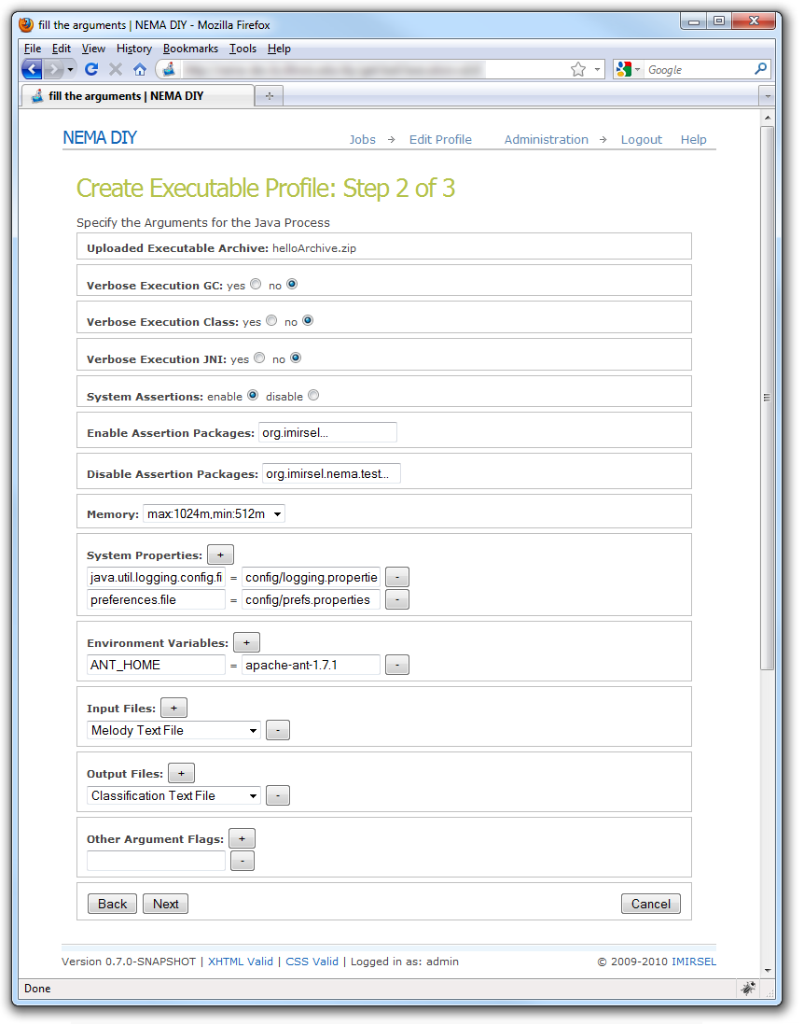
Configuring Remote Components
After uploading the executable, the user can supply further configuration information
System properties
Arguments
Environment variables
Input & output file formats

Slide 24
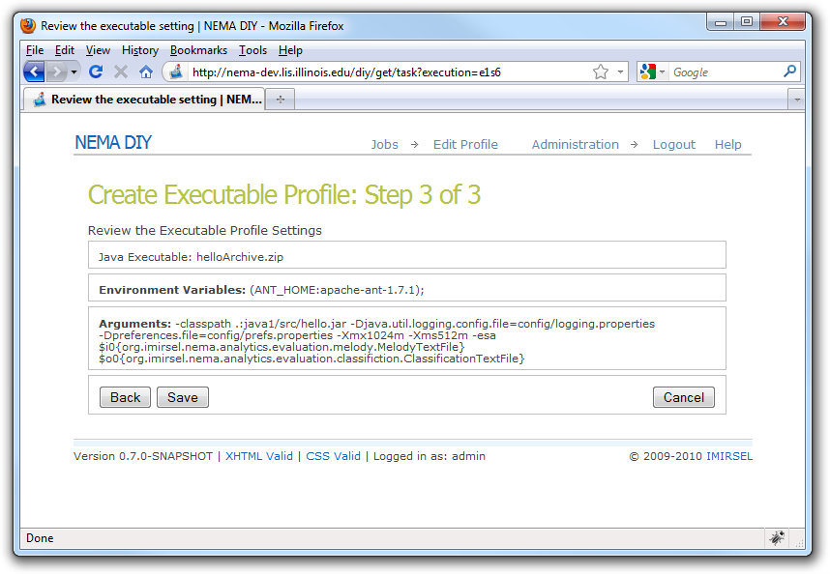
Configuring Remote Components
A preview of the complete executable profile is displayed prior to submission
When a save is triggered, the completed profile is persisted to the remote Content Repository Service

Slide 25
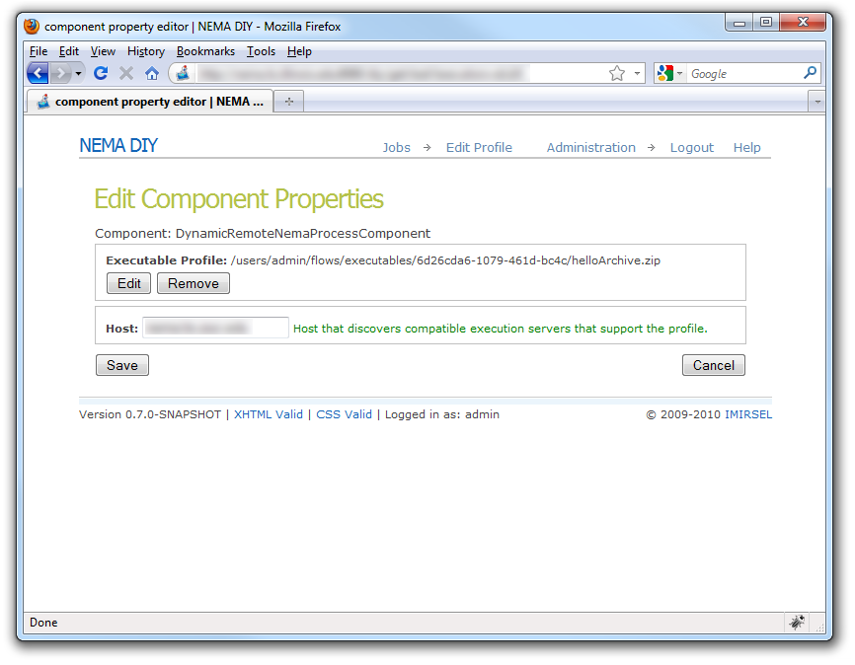
Configuring Remote Components
The “Executable Profile” property is now populated with the location of the profile in the Content Repository

Slide 26
Submitting Jobs
After the user submits a job for execution, the web application creates a new “flow instance” preserving the user-configured flow state
The web application then issues a job request to the Flow Service with a reference to the new flow instance

Slide 27
Agenda
Definitions
Background
Project Goals
Implementation
MIR Tasks as Workflows
User Interface
Workflow Processing
Remote Executors
Job Results
Future Directions

Slide 28
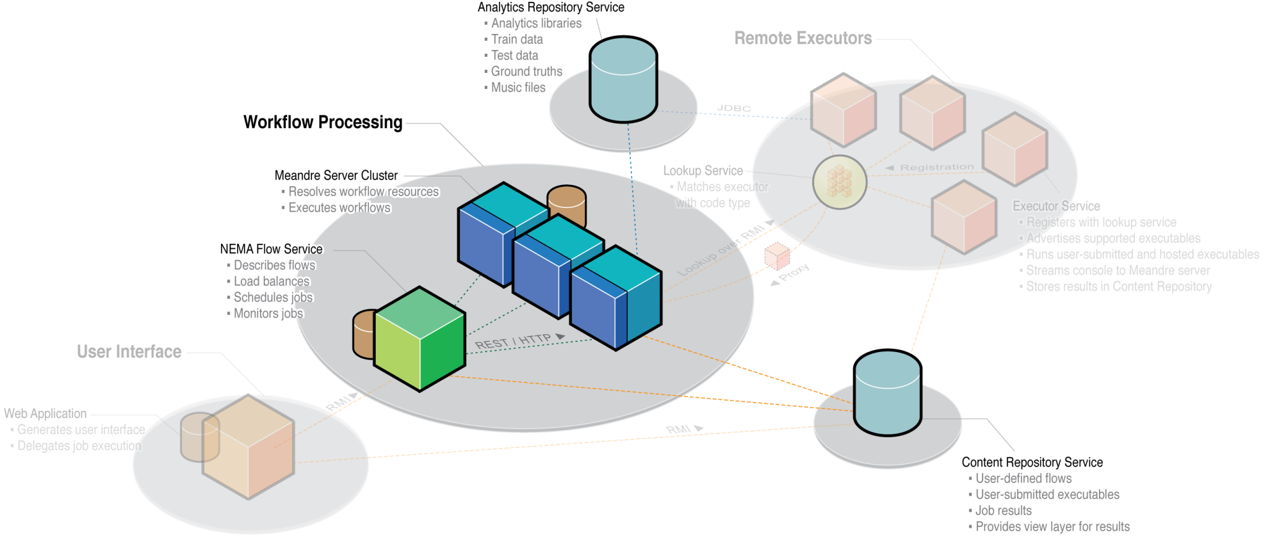
Workflow Processing

Slide 29
Flow Service
Abstraction layer between UI and Meandre Servers
Java application w/RMI service interface
Implements functionality for:
Load balancing
Job execution
Job monitoring
Job status notifications
Server monitoring
Also provides operations for:
Describing installed NEMA flow templates
Describing components and properties

Slide 30
Meandre Server
Provides a RESTful web service API
Operations for adding, querying & removing:
Repositories, components & flows
Operations for running and monitoring flows
NEMA Meandre Server cluster
1 head node
Flow Service uses for querying flows & components
N worker nodes
Flow Service uses for job execution

Slide 31
Meandre Server
Meandre repositories, components and flows are stored in RDF
Independent repositories can be dynamically merged
Flows may refer to components that reside at different URLs on the web
Execution-time component resolution
Given a flow model to execute, Meandre will resolve the components at runtime

Slide 32
Datasets
The dataset, along with the larger NEMA data model, supports all MIR scenarios experienced with MIREX
Other key objects used in our flows are contained by, or derived from, datasets
Audio tracks
Track metadata
Training and testing sets
Ground truths
Machine learning parameters
Datasets contain paths to the physical audio tracks

Slide 33
Agenda
Definitions
Background
Project Goals
Implementation
MIR Tasks as Workflows
User Interface
Workflow Processing
Remote Executors
Job Results
Future Directions

Slide 34
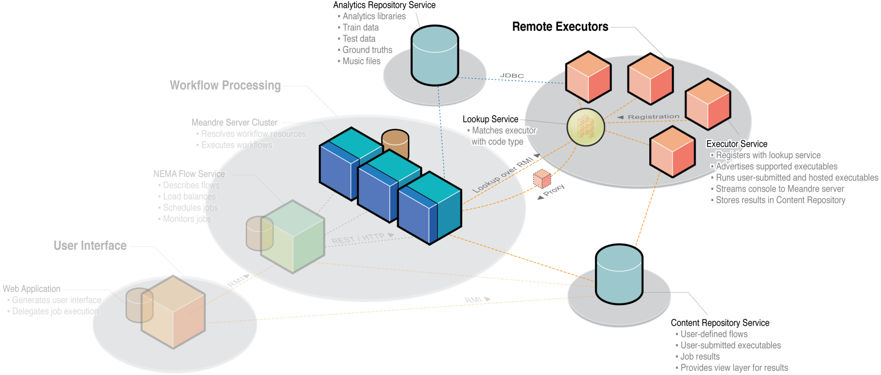
Remote Executors

Slide 35
Remote Executors
Client side
Implemented as a Meandre component
Gets the executable profile stored in the Content Repository
Queries the lookup service for Remote Executors capable of running the executable
Delegates processing to the Remote Executor
Remotely monitors process lifecycle, output/error streams, and process results

Slide 36
Remote Executors
Client side
Implemented as a Meandre component
Gets the executable profile stored in the Content Repository
Queries the lookup service for Remote Executors capable of running the executable
Delegates processing to the Remote Executor
Remotely monitors process lifecycle, output/error streams, and process results

Slide 37
Remote Executors
Service Side (placed at the data)
JINI-based service
Registers itself with the lookup service
Advertises supported executable types, host OS, etc.
For dynamic executables, downloads executable archive from the Content Repository Service
Queues process requests if server is already processing maximum number
Runs processes using Java ProcessBuilder class
Stores results in the Content Repository Service

Slide 38
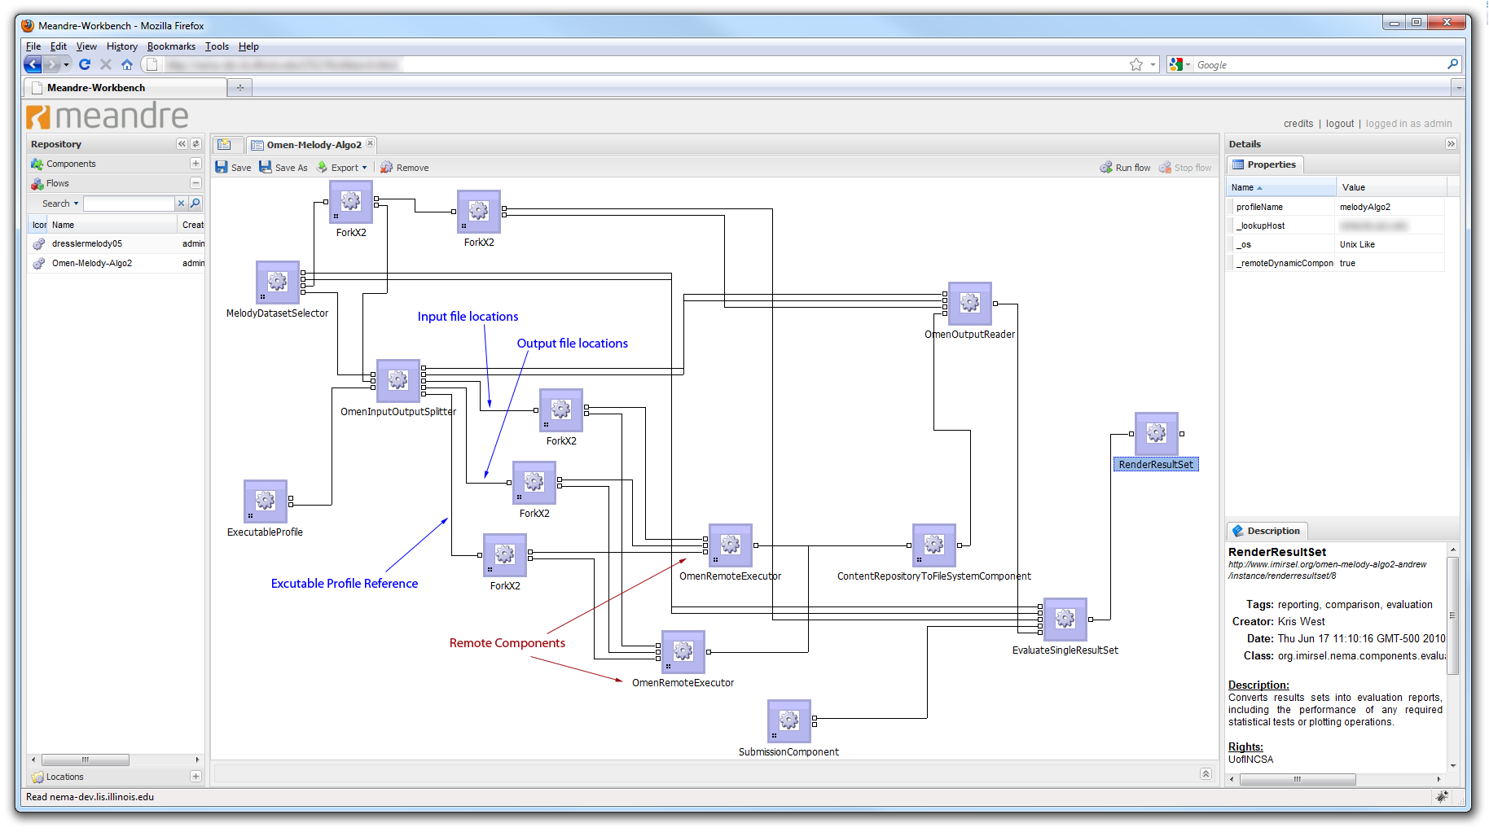
Multiple Remote Executors

Slide 39
Agenda
Definitions
Background
Project Goals
Implementation
MIR Tasks as Workflows
User Interface
Workflow Processing
Remote Executors
Job Results
Future Directions

Slide 40
Job Results
Results are generated by user code in a format specified in the executable profile
Remote Executors save results to the Content Repository
Downstream components, running on the Meandre Server, copy the results locally for use by an evaluation component
After the evaluation component runs, a report is generated that summarizes the evaluation

Slide 41
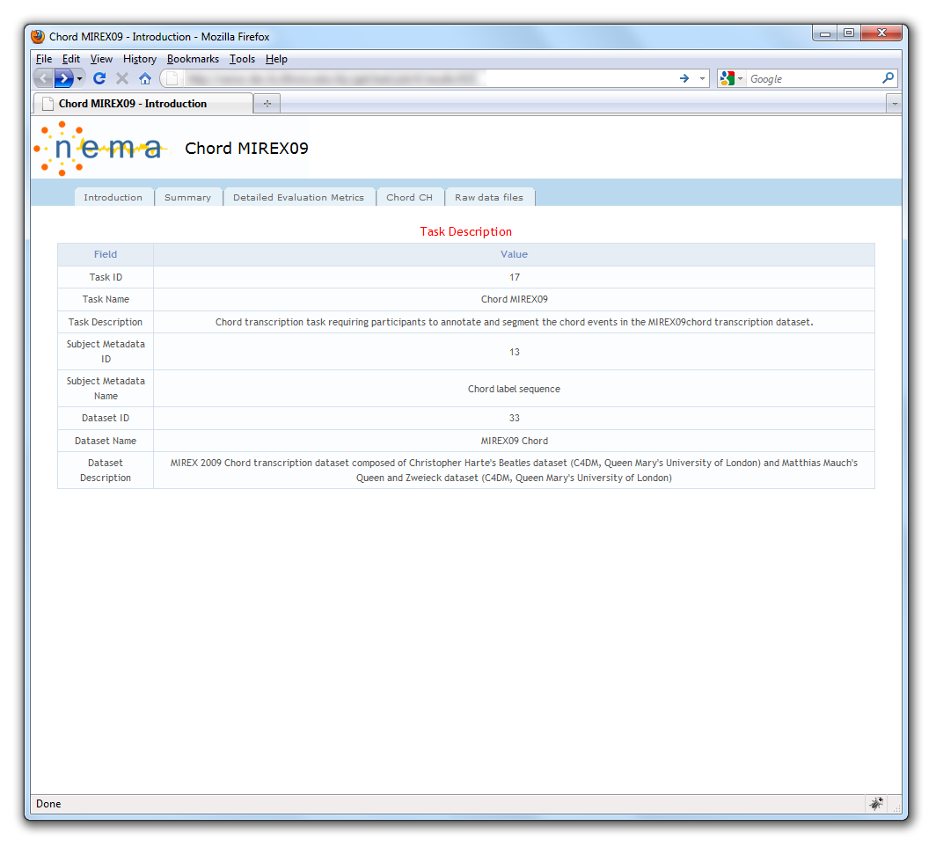
Evaluation Reports
Evaluation reports are made available in the UI along with other job details
Shown is a chord transcription report

Slide 42
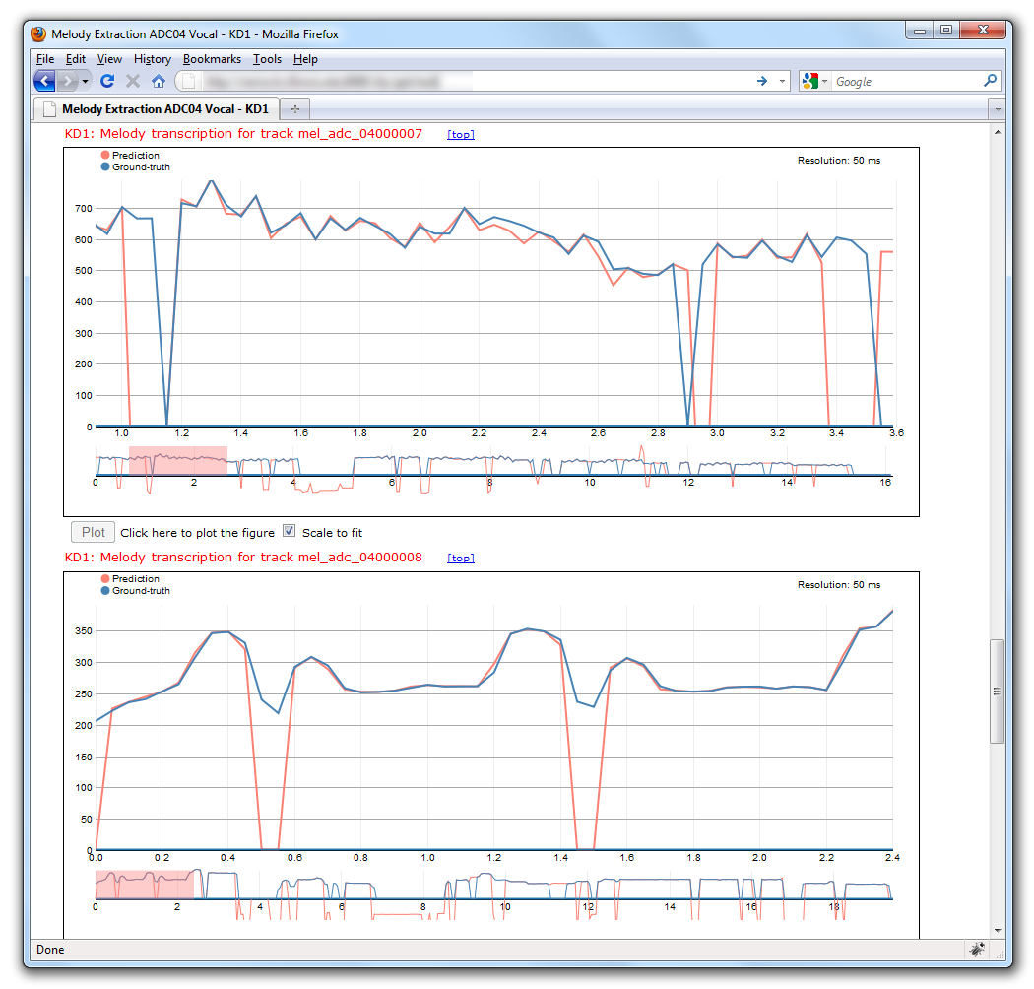
Evaluation Reports
Melody extraction result plots
Each plot represents the system’s performance for a single song in the dataset
Blue lines are ground truth
Pink lines are predictions
X axis is time in seconds
Y axis is frequency in Hertz

Slide 43
Agenda
Definitions
Background
Project Goals
Implementation
MIR Tasks as Workflows
User Interface
Workflow Processing
Remote Executors
Job Results
Future Directions

Slide 44
Future Directions
Additional partner collection sites
Integration with myExperiment
UI improvements
User-configurable VMs
Year-round access

Slide 45
Future Directions
Additional partner collection sites
Integration with myExperiment
UI improvements
User-configurable VMs
Year-round access

Slide 46
Thank you
For more information:
Andrew Shirk
shirk@illinois.edu

Slide 48
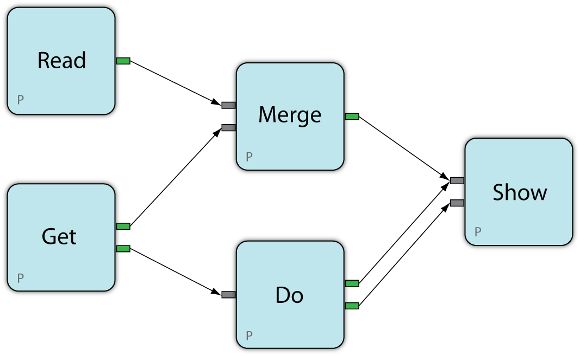
Tasks as Workflows
A task is a collection of connected components with inputs, outputs and configurable properties

Slide 49
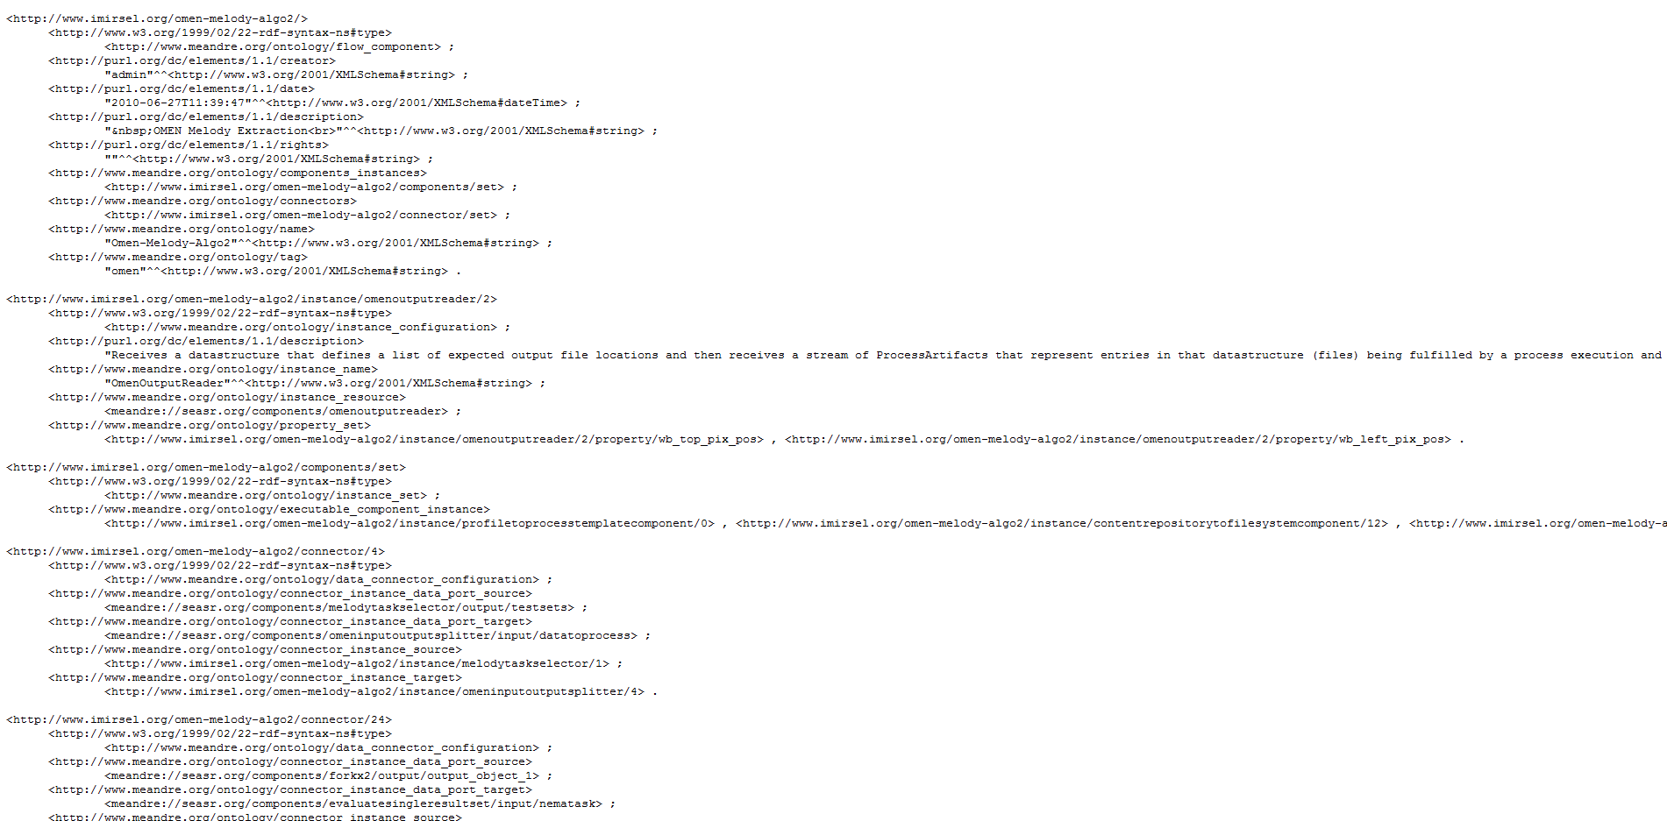
Meandre Repository RDF

Slide 50
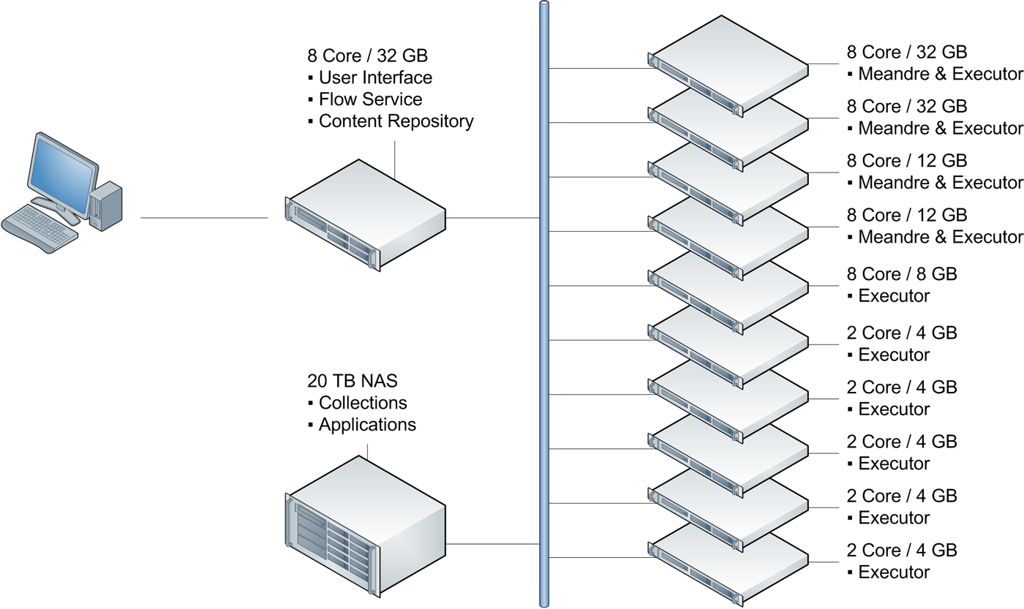
NEMA System Overview (Physical)

Slide 51
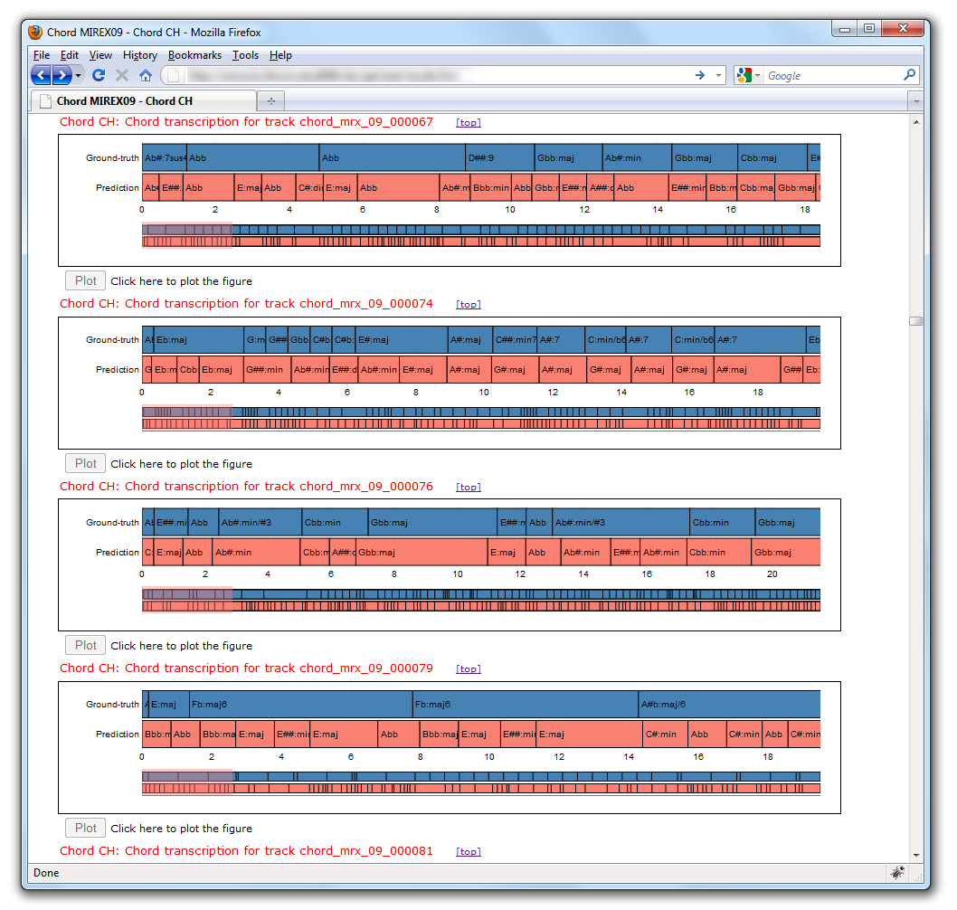
Job Results
Chord transcription result plots
Each plot represents the system’s performance for a single song in the dataset
Blue is ground truth
Pink is the prediction
X axis is time
Vertical lines delineate chord instances

